Slide 1
Chapter 2
Basic Elements of C++

Slide 2
Objectives (1 of 3)
In this chapter, you will:
  Become familiar with the basic components of a C++ program, including functions, special symbols, and identifiers
  Explore simple data types
  Discover how to use arithmetic operators
  Examine how a program evaluates arithmetic expressions
  Become familiar with the string data type
  Learn what an assignment statement is and what it does

Slide 3
Objectives (2 of 3)
  Learn about variable declaration
  Discover how to input data into memory using input statements
  Become familiar with the use of increment and decrement operators
  Examine ways to output results using output statements
  Learn how to use preprocessor directives and why they are necessary

Slide 4
Objectives (3 of 3)
  Learn how to debug syntax errors
  Explore how to properly structure a program, including using comments to document a program
  Become familiar with compound statements
  Learn how to write a C++ program

Slide 5
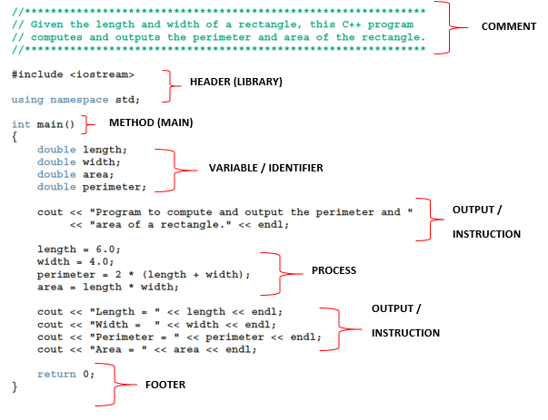
A Quick Look at a C++ Program (1 of 5)

Slide 6
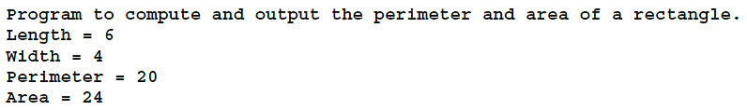
A Quick Look at a C++ Program (2 of 5)
Sample Run:

Slide 7
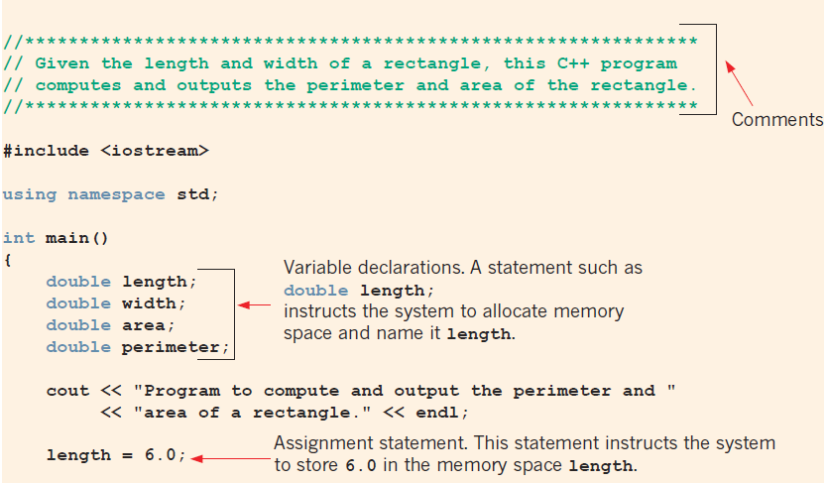
A Quick Look at a C++ Program (3 of 5)
FIGURE 2-1 Various parts of a C++ program

Slide 8
A Quick Look at a C++ Program (4 of 5)
FIGURE 2-1 Various parts of a C++ program (cont’d.)

Slide 9
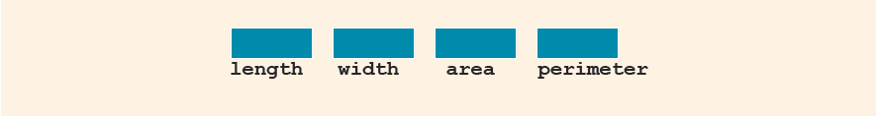

A Quick Look at a C++ Program (5 of 5)
Variable: a memory location whose contents can be changed
FIGURE 2-3 Memory allocation
FIGURE 2-4 Memory spaces after the statement length = 6.0; executes

Slide 10
Comments
Comments are for the reader, not the compiler
Two types
  Single line: begins with //
//**************************************************************
// Given the length and width of a rectangle, this C++ program
// computes and outputs the perimeter and area of the rectangle.
//**************************************************************
  Multiple line: enclosed between /* and */
/*
You can include comments that can
occupy several lines.
*/

Slide 11
Special Symbols
A token is the smallest individual unit of a program written in any language
C++ tokens include special symbols, word symbols, and identifiers
Special symbols in C++ include:
  + - * /
  . ; ? ,
  <= != == >=

Slide 12
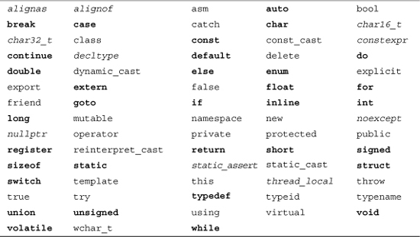
Reserved Words (Keywords)
Reserved word symbols (or keywords):
  Cannot be redefined within a program
  Cannot be used for anything other than their intended use
Examples include:

Slide 13
Identifiers / Variable (1 of 4)
Firstly, we will look at the variables. Variables represent all the data used in the program to produce the required solution and also the result of the calculations.
All the data needed to solve the problem is known as input data, while the resulting information produced is known as output data.
Variables can be defined as a memory allocation that will hold data and the values will keep on changing during program execution.
Input data is the data needed to solve a problem.
Output data, or information, is the data that has been processed by a computer.

Slide 14
Identifiers / Variable (2 of 4)
There are normal variables, and variables that have fixed values that cannot be changed.
Variables that has a fixed value are known as constant variables. For example, PI (π) = 3.142, whereby the value of PI is fixed for any situation.
An identifier is a name given to a variable, constant variable, function or label.

Slide 15
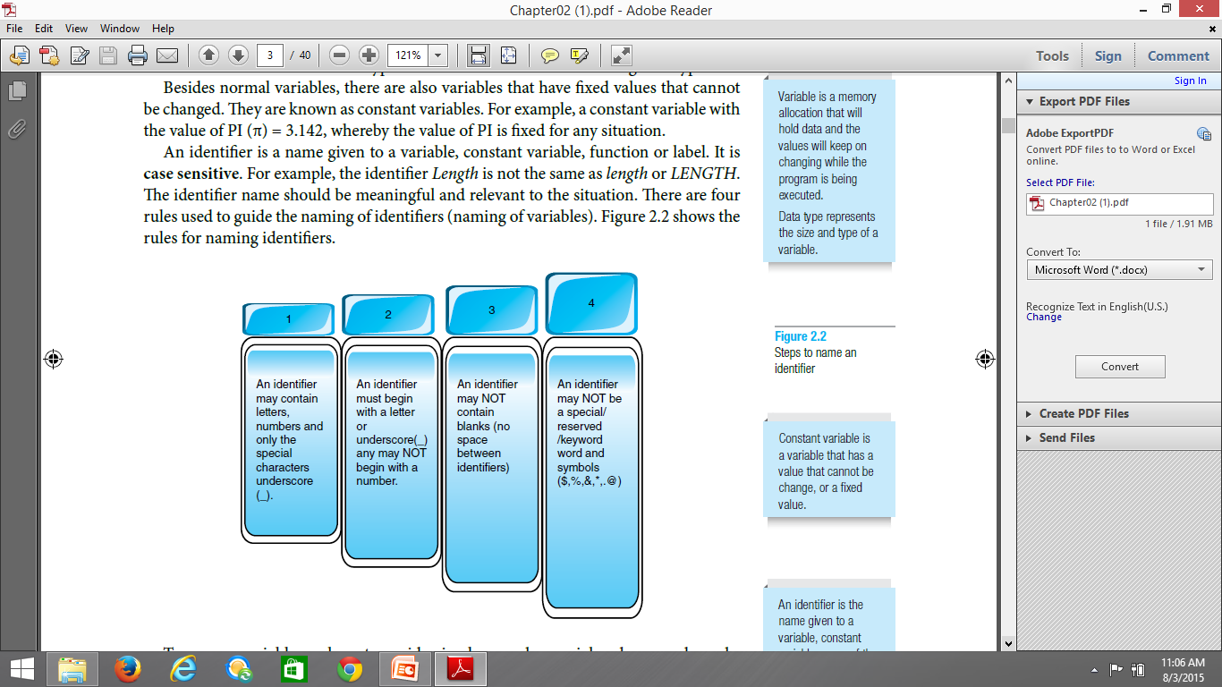
Identifiers / Variable (3 of 4)
Rules to write identifier name:

Slide 16
Identifiers / Variable (4 of 4)
Legal identifiers in C++
  first
  conversion
  payRate
TABLE 2-1 Examples of Illegal Identifiers
Illegal Identifier | Reason | A Correct Identifier
employee Salary | There can be no space between employee and Salary. | employeeSalary
Hello! | The exclamation mark cannot be used in an identifier. | Hello
one+two | The symbol + cannot be used in an identifier. | onePlusTwo
2nd | An identifier cannot begin with a digit. | second

Slide 17
Data Types
All the variables and constants have to be declared before they are used in the program.
To declare the variables, we have to identify the categories of data and name each uniquely.
It is because once we declare the variable, a memory space will be provided.
So, to allocate the size, we have to base it on the variable categories.
Data type represents the size and type of a variable.

Slide 18
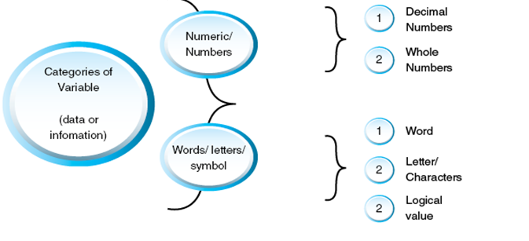
Data Types
Categories of data type

Slide 19
int Data Type
Examples
  -6728
  0
  78
  +763
Positive integers do not require a + sign
A comma cannot be used within an integer
  Commas are only used for separating items in a list

Slide 20
bool Data Type
bool type
  Two values: true and false
  Purpose: to manipulate logical (Boolean) expressions
true and false
  Logical values
bool, true, and false
  Reserved words

Slide 21
char Data Type (1 of 2)
Data type char is the smallest integral data type
It is used for single characters: letters, digits, and special symbols
Each character is enclosed in single quotes
  'A', 'a', '0', '*', '+', '$', '&'
A blank space is a character
  Written ' ', with a space left between the single quotes

Slide 22
Floating-Point Data Types (1 of 3)
C++ uses scientific notation to represent real numbers (floating-point notation)
TABLE 2-3 Examples of Decimal Numbers in Scientific and C11 Floating-Point Notations
Decimal Number | Scientific Notation | C++ Floating-Point Notation
75.924 | 7.5924 * 10¹ | 7.592400E1
0.18 | 1.8 * 10⁻¹ | 1.800000E-1
0.0000453 | 4.53 * 10⁻⁵ | 4.530000E-5
–1.482 | -1.482 * 10⁰ | -1.482000E0
7800.0 | 7.8 * 10³ | 7.800000E3

Slide 23
Floating-Point Data Types (2 of 3)
float: represents any real number
  Range: -3.4 * 10³⁸ to 3.4 * 10³⁸ (four bytes)
double: represents any real number
  Range: –1.7 * 10³⁰⁸ to 1.7 * 10³⁰⁸ (eight bytes)
Minimum and maximum values of data types are system dependent

Slide 24
Floating-Point Data Types (3 of 3)
Maximum number of significant digits (decimal places) for float values: 6 or 7
Maximum number of significant digits for double: 15
Precision: maximum number of significant digits
  float values are called single precision
  double values are called double precision

Slide 25
Data Types, Variables, and Assignment Statements
To declare a variable, must specify its data type
Syntax rule to declare a variable is:
  dataType identifier;
Examples include:
int counter;
double interestRate;
char grade;
Assignment statement has the form: variable = expression
  Example: interestRate = 0.05;

Slide 26
Form and Style
Consider two ways of declaring variables:
  Method 1
  int feet, inches;
  double x, y;
  Method 2
  int feet,inches; double x,y;
Both are correct; however, the second is harder to read

Slide 27
Arithmetic Operators, Operator Precedence, and Expressions (1 of 2)
C++ arithmetic operators include:
  + addition
  - subtraction (or negation)
  * multiplication
  / division
  % mod (modulus or remainder)
+, -, *, and / can be used with integral and floating-point data types
Modulus (%) can only be used with integral data types

Slide 28
Arithmetic Operators, Operator Precedence, and Expressions (2 of 2)
When you use / with integral data types, the integral result is truncated (no rounding)
Arithmetic expressions contain values and arithmetic operators
Operands are the numbers appearing in the expressions
Operators can be unary (one operand) or binary (two operands)

Slide 29
Order of Precedence
All operations inside () are evaluated first
*, /, and % are at the same level of precedence and are evaluated next
+ and - have the same level of precedence and are evaluated last
When operators are on the same level
  Operations are performed from left to right (associativity)
3 * 7 - 6 + 2 * 5 / 4 + 6 means
(((3 * 7) – 6) + ((2 * 5) / 4 )) + 6

Slide 30
Expressions
Integral expression: all operands are integers
  Yields an integral result
  Example: 2 + 3 * 5
Floating-point (decimal) expression: all operands are floating-point
  Yields a floating-point result
  Example: 12.8 * 17.5 - 34.50

Slide 31
Mixed Expressions (1 of 2)
Mixed expression
  Has operands of different data types
  Contains integers and floating-point
Examples of mixed expressions
  2 + 3.5
  6 / 4 + 3.9
  5.4 * 2 – 13.6 + 18 / 2

Slide 32
Mixed Expressions (2 of 2)
Evaluation rules
  If operator has same types of operands
    The operator is evaluated according to the type of the operands
  If operator has both types of operands
    Integer is changed to floating-point
    Operator is evaluated
    Result is floating-point
  Entire expression is evaluated according to precedence rules

Slide 33
Mixed Expressions (2 of 3)
Given:
int X; double Y;
Y = 3.4; X = 12;
int (Y) + X = Y
So, answer is Y = 15
    X + Y = Y
So, answer is Y = 15.4

Slide 34

Assignment Statement (1 of 4)
The assignment statement takes the form:
Expression is evaluated and its value is assigned to the variable on the left side
A variable is said to be initialized the first time a value is placed into it
In C++, = is called the assignment operator

Slide 35

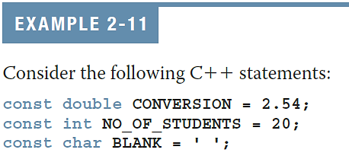
Constants / Assignment Statement (1 of2)
Named constant: memory location whose content cannot change during execution
Syntax to declare a named constant
In C++, const is a reserved word

Slide 36
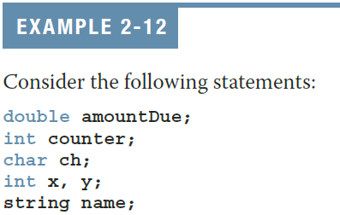
Constants / Assignment Statement (2 of2)
Variable: memory location whose content may change during execution
Syntax to declare one or multiple variables

Slide 37
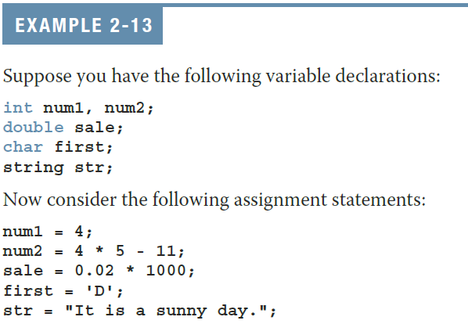
Assignment Statement (2 of 4)

Slide 38

Input (Read) Statement (1 of 3)
cin is used with >> to gather one or more inputs
This is called an input (read) statement
The stream extraction operator is >>
For example, if miles is a double variable:
cin >> miles;
  Causes the computer to get a value of type double and places it in the variable miles

Slide 39
Output (1 of 4)
The syntax of cout and << is:
  Called an output statement
The stream insertion operator is <<
Expression evaluated and its value is printed at the current cursor position on the screen

Slide 40
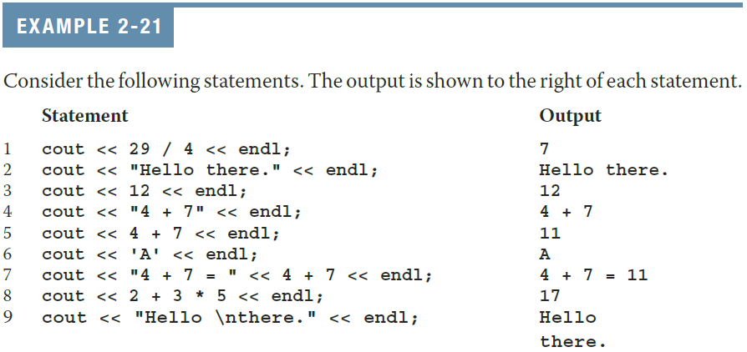
Output (2 of 4)
A manipulator is used to format the output
  Example: endl causes the insertion point to move to beginning of next line

Slide 41
Output (3 of 4)
The new line character (new line escape sequence) is '\n'
  May appear anywhere in the string
Examples
  cout << "Hello there.";
  cout << "My name is James.";
  Output:
  Hello there.My name is James.
  cout << "Hello there.\n";
  cout << "My name is James.";
  Output :
  Hello there.
  My name is James.

Slide 42
Prompt Lines
Prompt lines: executable statements that inform the user what to do
  cout << "Please enter a number between 1 and 10 and "
  << "press the return key" << endl;
  cin >> num;
Always include prompt lines when input is needed from users

Slide 43
Preprocessor Directives (1 of 2)
C++ has a small number of operations
Many functions and symbols needed to run a C++ program are provided as collection of libraries
Every library has a name and is referred to by a header file
Preprocessor directives are processed by the preprocessor program
All preprocessor commands begin with #
No semicolon is placed at the end of these commands

Slide 44

Preprocessor Directives (2 of 2)
Syntax to include a header file
For example:
  #include <iostream>
  Causes the preprocessor to include the header file iostream in the program
Preprocessor commands are processed before the program goes through the compiler

Slide 45
namespace and Using cin and cout in a Program
cin and cout are declared in the header file iostream, but within std namespace
To use cin and cout in a program, use the following two statements:
#include <iostream>
using namespace std;

Slide 46
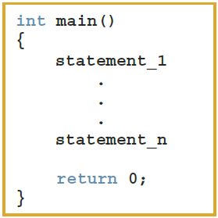
Creating a C++ Program (1 of 3)
A C++ program is a collection of functions, one of which is the function main
The syntax of the function main used in this book has this form:

Slide 47
Creating a C++ Program (2 of 3)
Source code is comprised of preprocessor directives and program statements
The source code file (source file) contains the source code
The compiler generates the object code (file extension .obj)
Executable code (file extension .exe) results when object code is linked with the system resources
The first line of the function main is called the heading of the function:
  int main()

Slide 48
Creating a C++ Program (3 of 3)
The statements enclosed between the curly braces ({ and }) form the body of the function
A C++ program contains two types of statements:
  Declaration statements declare things, such as variables
  Executable statements perform calculations, manipulate data, create output, accept input, etc.

Slide 49
More on Assignment Statements
Two forms of assignment
  Simple and compound
  Compound operators provide more concise notation
Compound operators: +=, -=, *=, /=, %=
Simple assignment statement example
x = x * y;
Compound assignment statement example
x *= y;

Slide 50
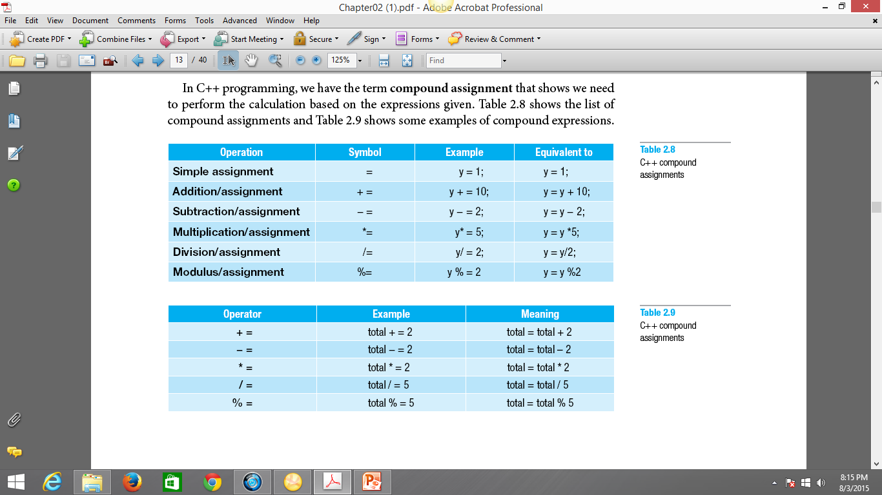
C++ Compound Assignments

Slide 51
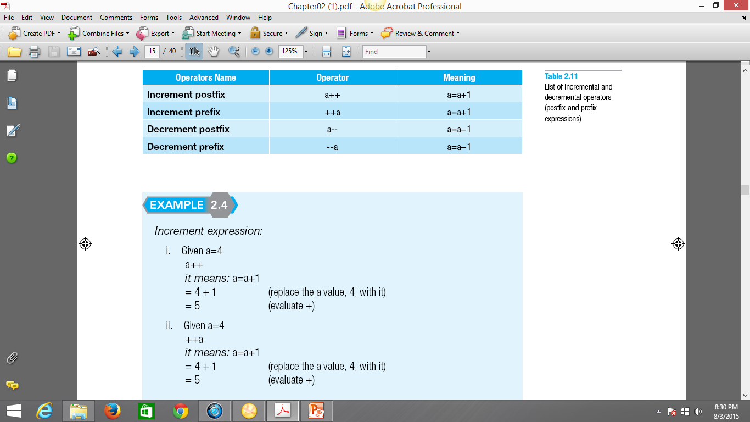
Increment and Decrement Operators (Postfix & Prefix)
Postfix is a process of performing the expression after the evaluation.
Prefix is a process of performing the evaluation immediately.
Increment is the process of adding value to a variable.
Decrement is the process of subtracting the value in a statement.

Slide 52
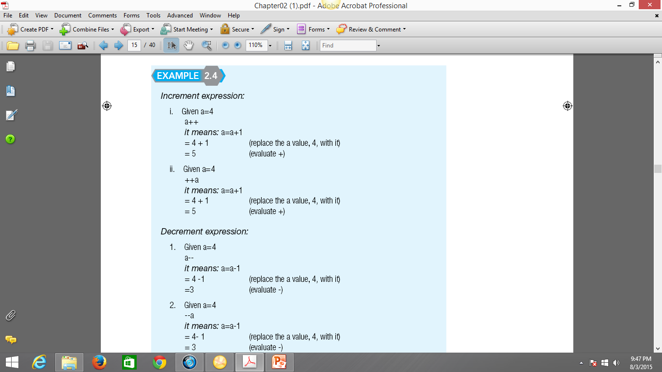
Increment and Decrement Operators (Postfix & Prefix) (cont.)

Slide 53
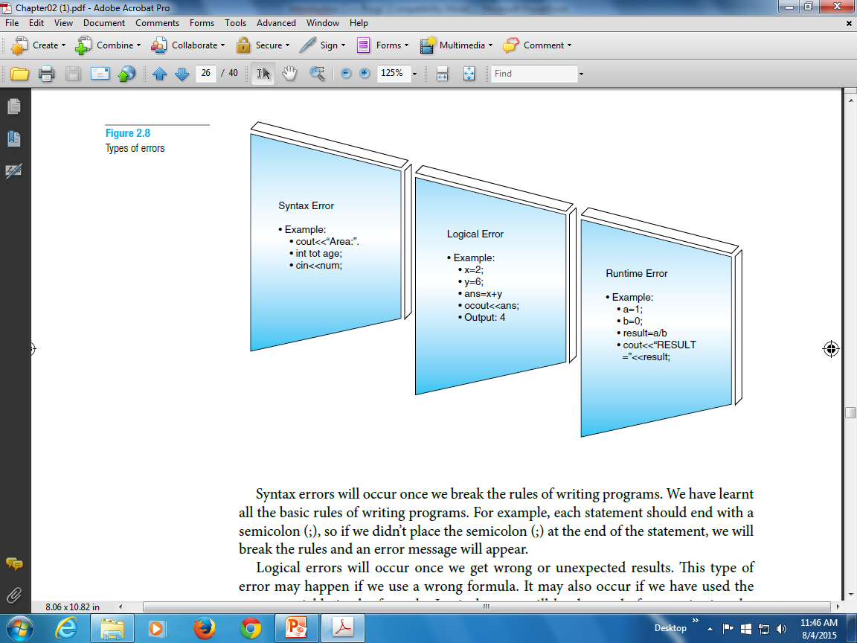
Types of Errors
The runtime errors will also be detected once we want to preview the
result. This can lead to the result not being displayed. The program will not stop running.
Syntax errors will occur once we break the rules of writing programs.
Logical errors will occur once we get wrong or unexpected results. This type of
error may happen if we use a wrong formula.

Slide 54
Quick Review (1 of 3)
A C++ program is a collection of functions, one of which is always called main
Identifiers consist of letters, digits, and underscores, and begin with a letter or an underscore
The arithmetic operators in C++ are addition (+), subtraction (-), multiplication (*), division (/), and modulus (%)
Arithmetic expressions are evaluated using the precedence associativity rules

Slide 55
Quick Review (2 of 3)
All operands in an integral expression are integers
All operands in a floating-point expression are decimal numbers
A mixed expression contains both integers and decimal numbers
Use the cast operator to explicitly convert values from one data type to another
A named constant is initialized when declared
All variables must be declared before used

Slide 56
Quick Review (3 of 3)
Use cin and the stream extraction operator >> to input from the standard input device
Use cout and the stream insertion operator << to output to the standard output device
Preprocessor commands are processed before the program goes through the compiler
A file containing a C++ program usually ends with the extension .cpp

